Slide 1

The GAAS Metagenomic Tool and Its Estimations of Viraland Microbial Average Genome Size in Four MajorBiomes

Slide 2
Metagenomic Analysis
Most methods extract DNA/RNA, then compare to NCBI sequences using BLAST to learn about the genomic composition of the sample
There is much more to learn!
Community composition is an important factor to understand about a biome

Slide 3
Community factors
The average genome length of a biome is related to the environmental complexity
Longer average genome length indicates higher complexity, as larger genomes can encode more genes
The distribution of genome lengths describes the diversity of the community

Slide 4
Describing Community Composition
High percentage of unknown organisms in samples, so we need similarity-independent methods
Needs average genome length as input, which can be obtained using Pulsed Field Gel Electrophoresis (PFGE)
  Larger size range and greater number of bands indicates wider variety of genomes
  Average genome length is related to biome complexity

Slide 5
PFGE Limitation
PFGE can discriminate and identify dominant viral populations, but doesn't always capture the larger picture of diversity
The bands produced in the process are not independent and a single band can contain different DNA sequences

Slide 6
GAAS
Doesn't rely on microbial marker
Uses a similarity-independent based method to estimate viral diversity
Is able to produces more accurate community composition and average genome length estimates than standard BLAST searches

Slide 7
GAAS specifics
Normalizes genome length to reduce sampling bias of genomes with longer length inherent in shotgun libraries
Improves both estimates of relative abundance of genomes and average genome size
Can be useful when organisms with small genomes are abundant (small RNA virus diseases)

Slide 8
Read length doesn't matter
Read length has no affect on GAAS accuracy of estimated genome lengths
Benchmarked on simulated viral genomes ranging from 50-800bp, all had virtually same accuracy
Shows short reads can be used to characterize communities

Slide 9
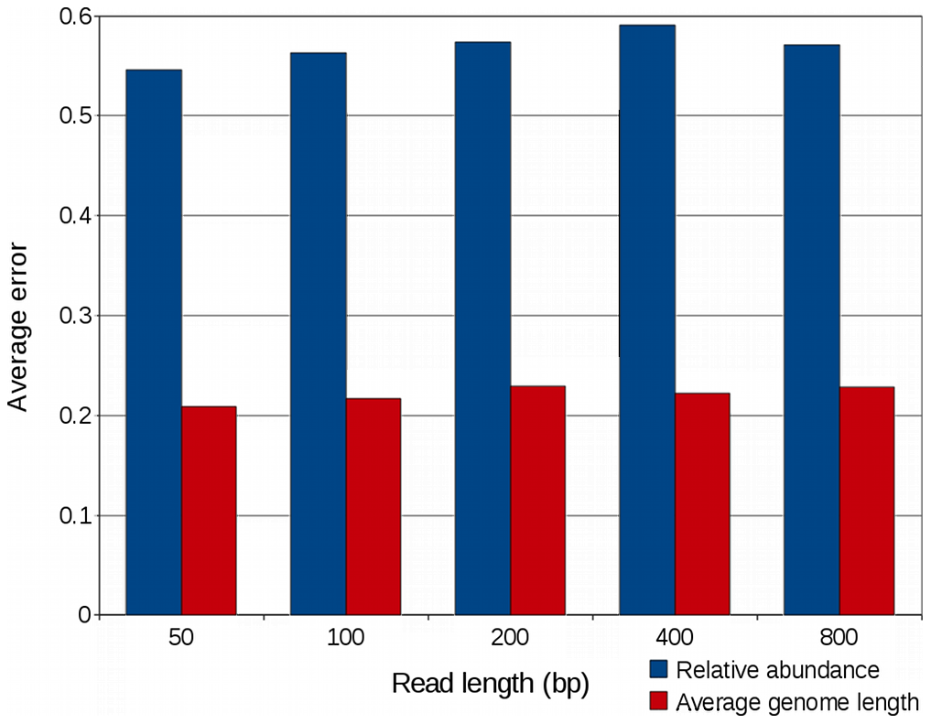

Slide 10
Re-analysis of Sargasso Sea
GAAS revealed:
  ~80% of viral community is composed of ssDNA viruses
  Chlamydia (79% vs. 15%) as most abundant phage vs. Prochlorococcus (16% vs. 64%)
  Species with larger genomes were less abundant than previously thought
  Normalizing by genome length essential for accurate estimation of community composition

Slide 11
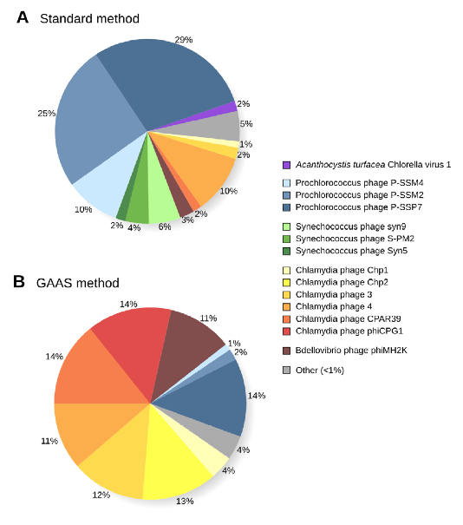

Slide 12
Genome length varies by Biome
Microbial and viral average genome length differed significantly across terrestrial, marine, and host-associated biomes
Also vary by sub-biome
  Ocean, freshwater, hypersaline, microbialites and hot springs all found to have differences in average genome length range
  Variability found to be much less in aquatic biome as a whole

Slide 13
Microbial and Viral Genome Lengths Independent
Across all biomes, it was shown that viral and microbial average genome lengths are independent of one another
Large viruses may be omitted using 0.22 um pore filters, but shouldn't account for these differences in genome length

Slide 14
Average microbial genome length was very different between 4 samples
  Differences reflect amounts of human disturbance
  More pathogens and heterotrophic microbes with increasing human activity
Viral portion of all 4 samples dominated by Synechococcus and Prochlorococcus phage

Slide 15
Environmental Stress Reactions
Stress in pH, temperature, nutrient, and DOC all resulted in increase of herpes-like viruses
  Could increase overall average viral genome size
Environmental stress cause variable effects on microbes
  Seems to make it difficult to draw conclusions

Slide 16
How it works
Is a standalone Perl software package
Runs BLAST analyses to determine significant similarities between metagenomic sequences and sequenced genomes
Selects the strongest matches based on a few selection factors (E-value, similarity, etc.)
Calculates genome length on random subsets of the sequences (averaged over many samples)

Slide 17
